Slide 1


EC2
Sameer Zulfi

Slide 2
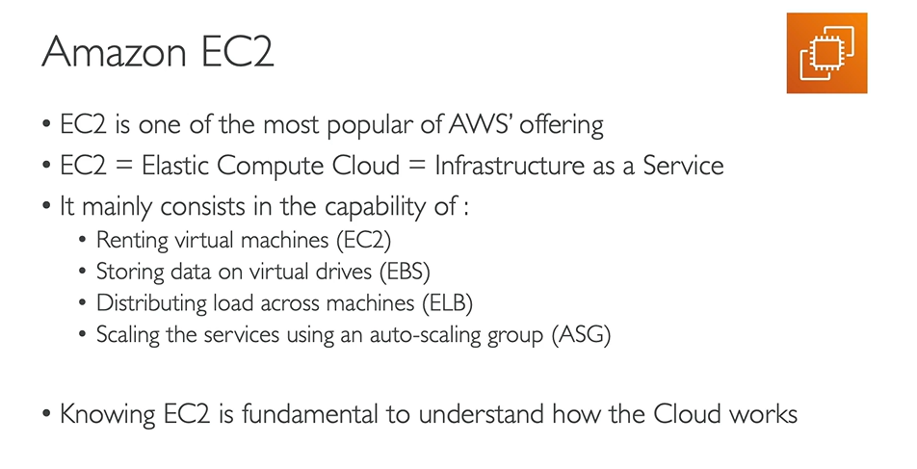
Amazon EC2

Slide 3
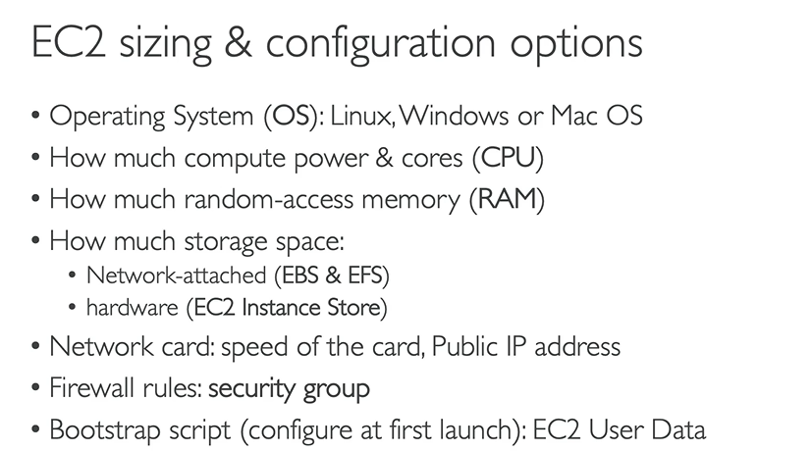
Amazon EC2

Slide 4
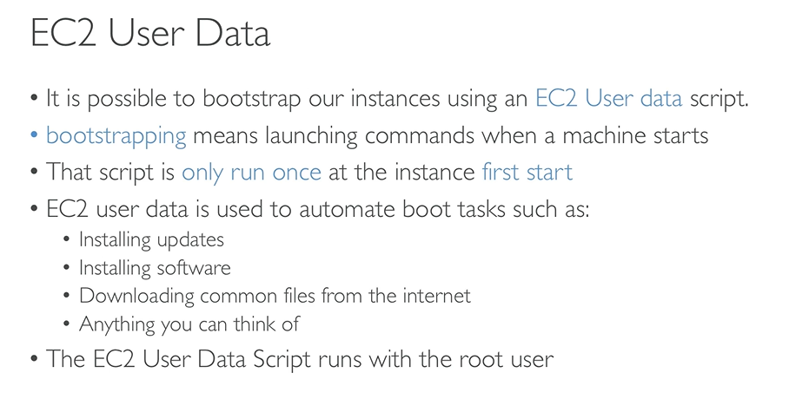
EC2 User Data

Slide 5
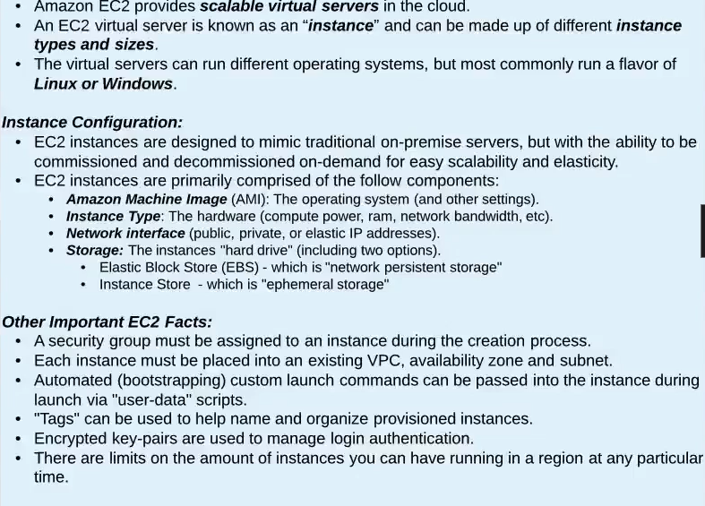
EC2 Essentials

Slide 6
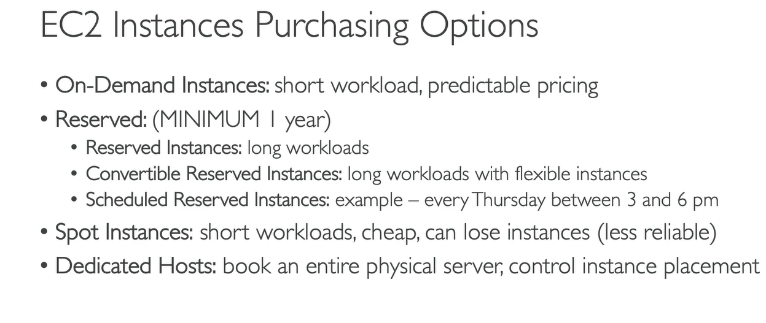
EC2 Purchasing Options

Slide 7
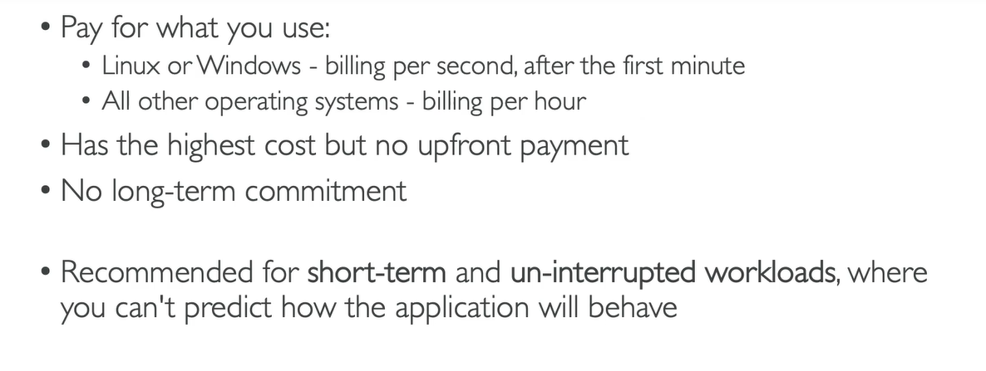
EC2 Purchasing Options

Slide 8
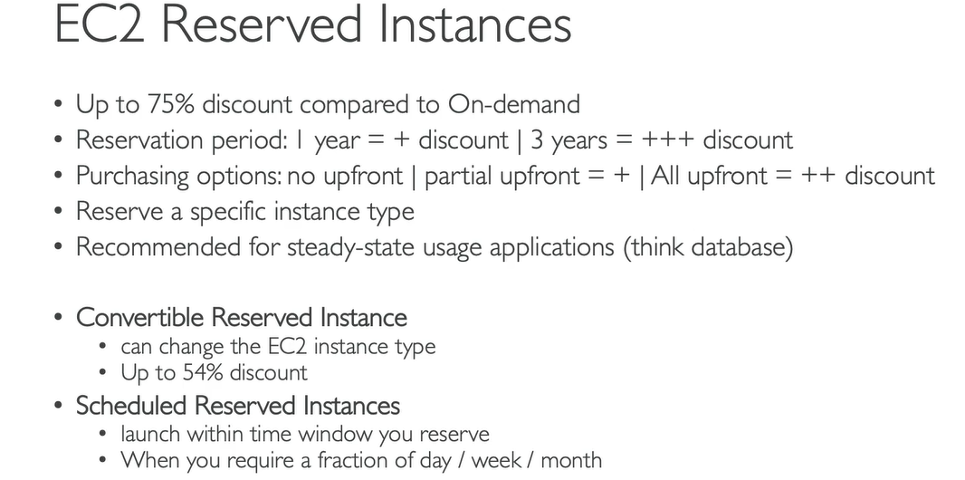
EC2 Purchasing Options

Slide 9
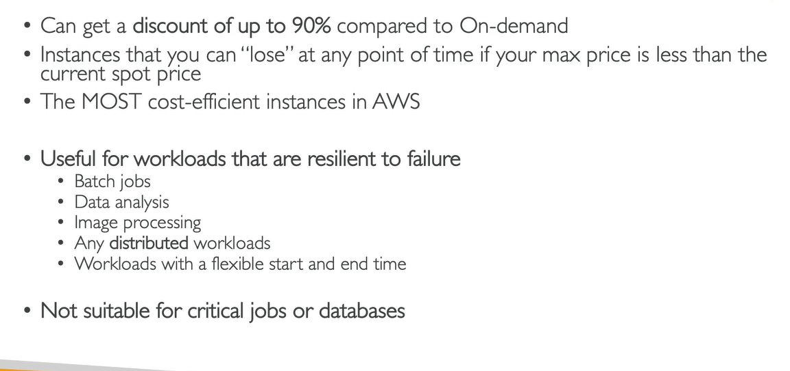
EC2 Spot

Slide 10
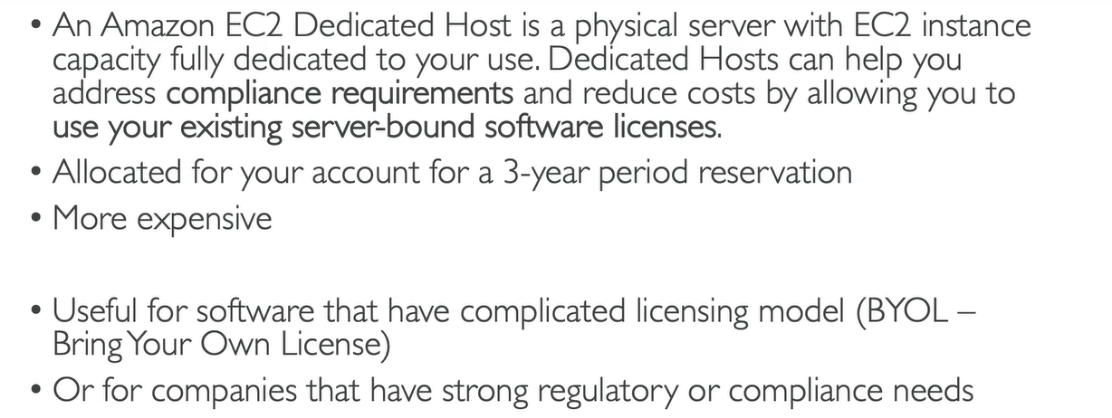
EC2 Dedicated Hosts

Slide 11
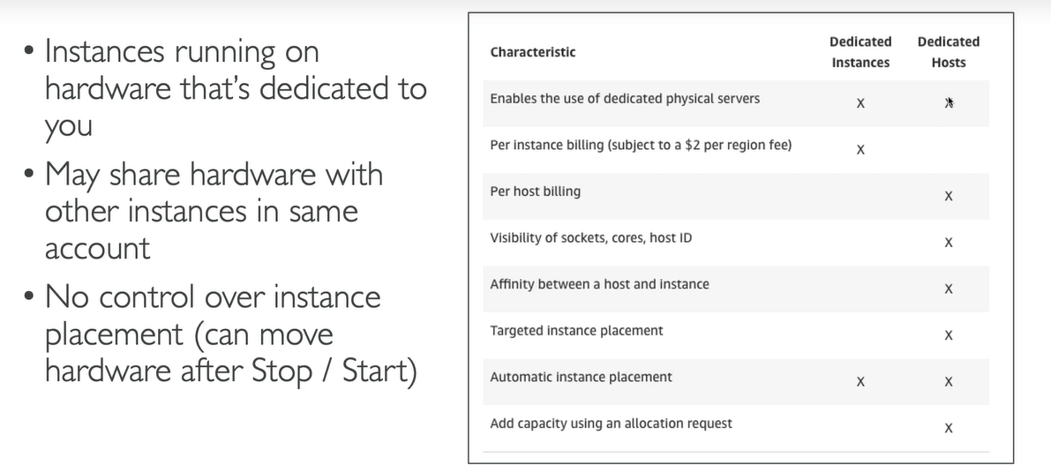
EC2 Dedicated Instances

Slide 12
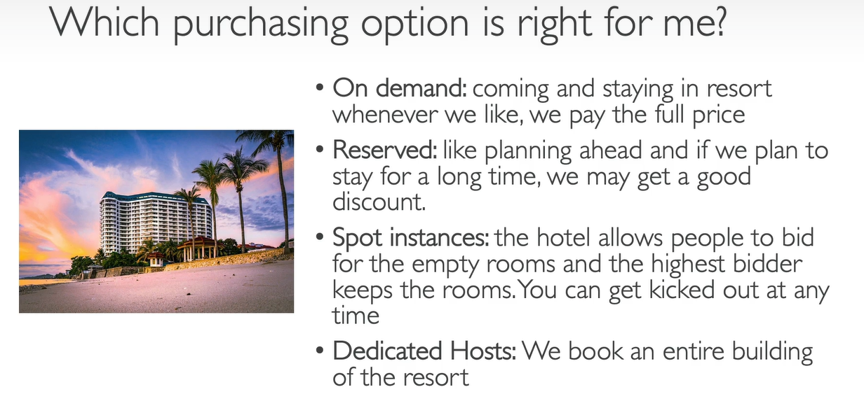
Which needs to be purchased?

Slide 13
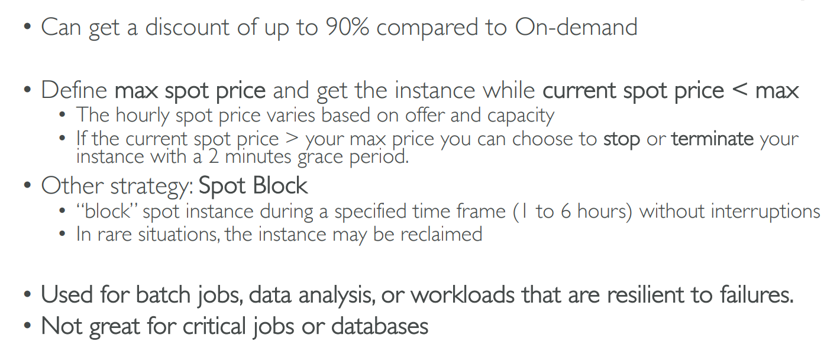
Spot Instance Requests

Slide 14
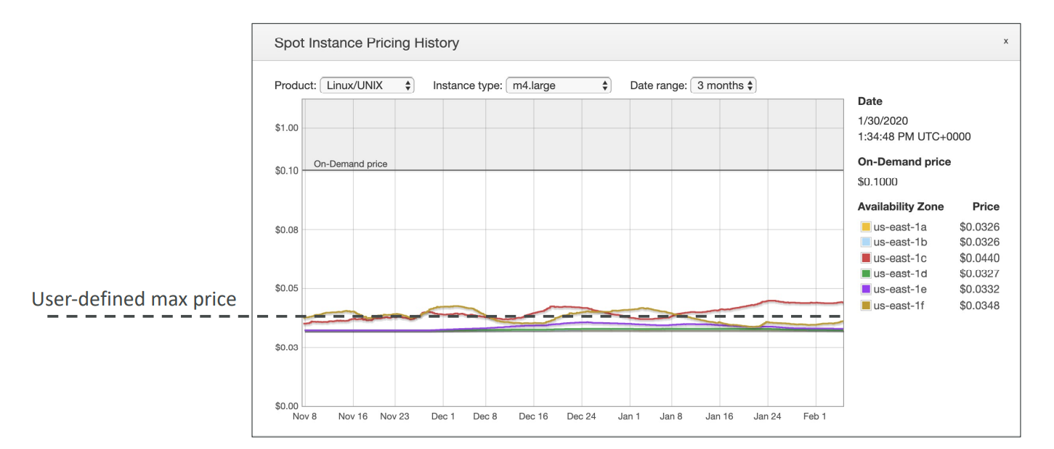
Spot Instances Pricing

Slide 15
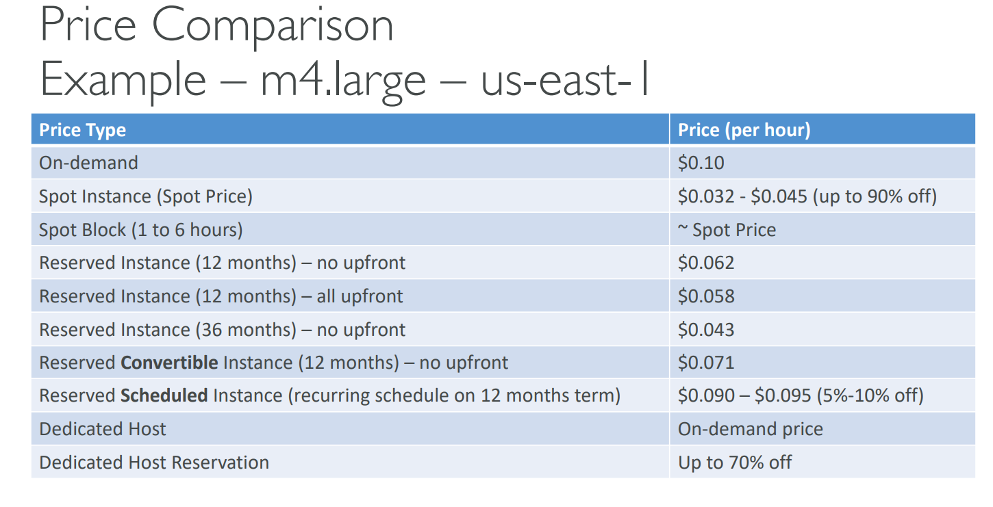
Price Comparison on Spot

Slide 16
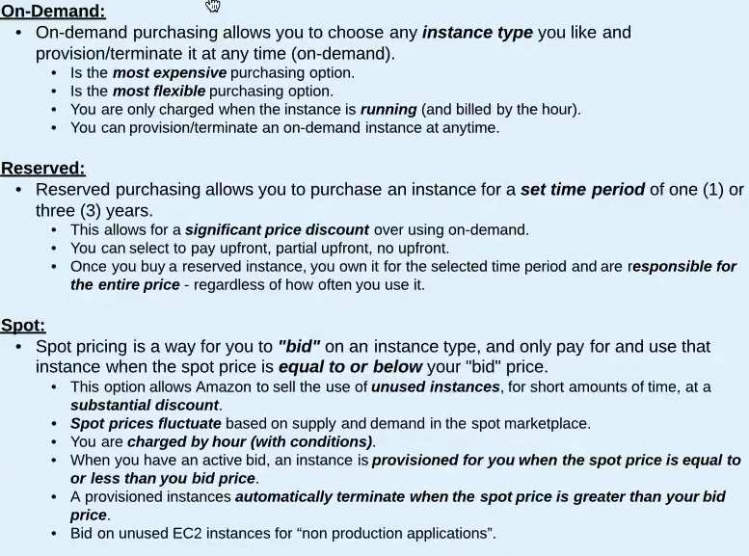
EC2 Purchasing Options

Slide 17
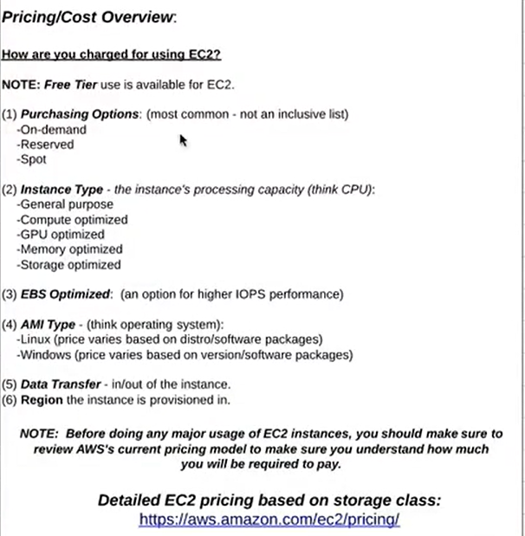
Pricing/Cost Overview

Slide 18
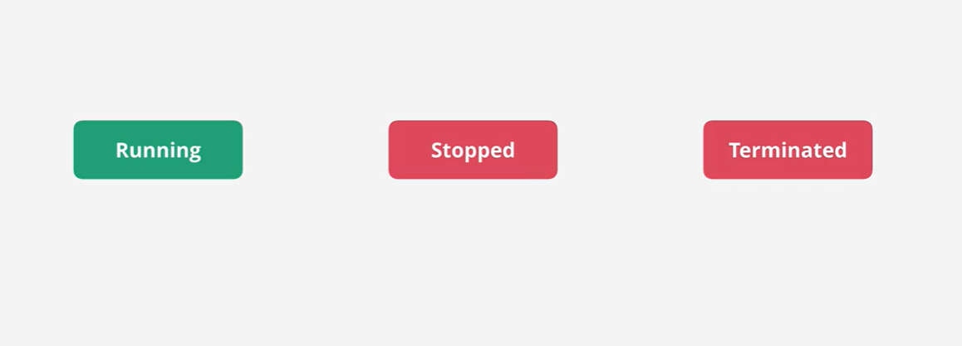
Instance LifeCycle

Slide 19
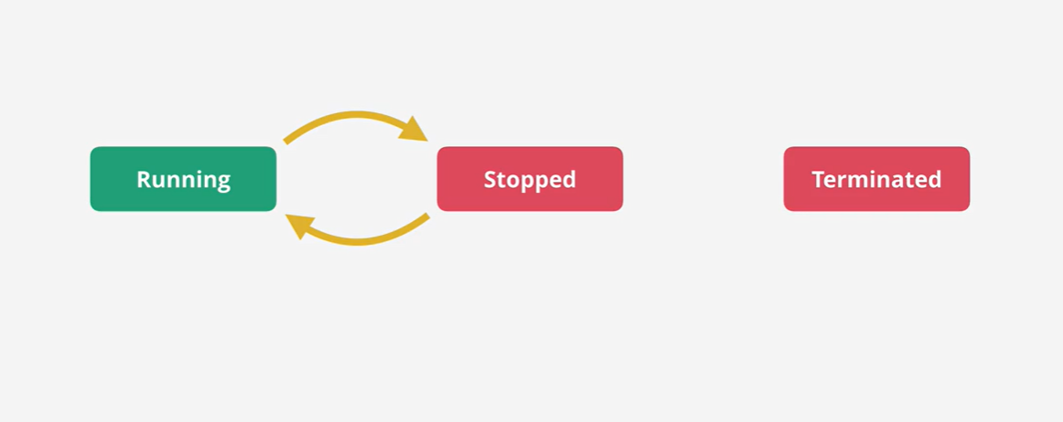
Instance LifeCycle

Slide 20
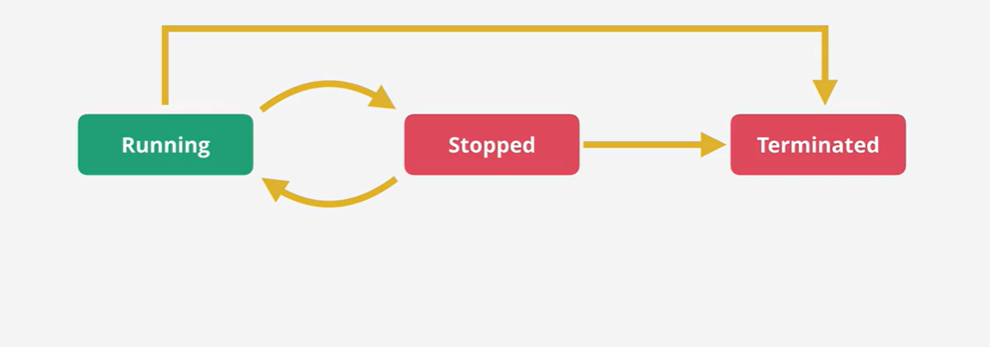
Instance LifeCycle

Slide 21
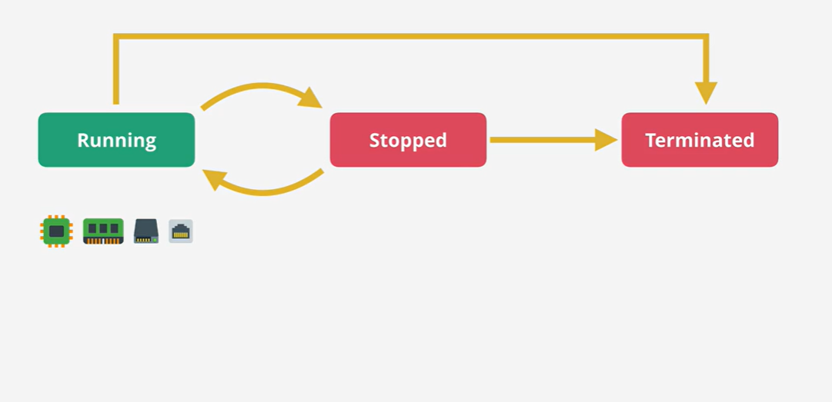
Instance LifeCycle

Slide 22
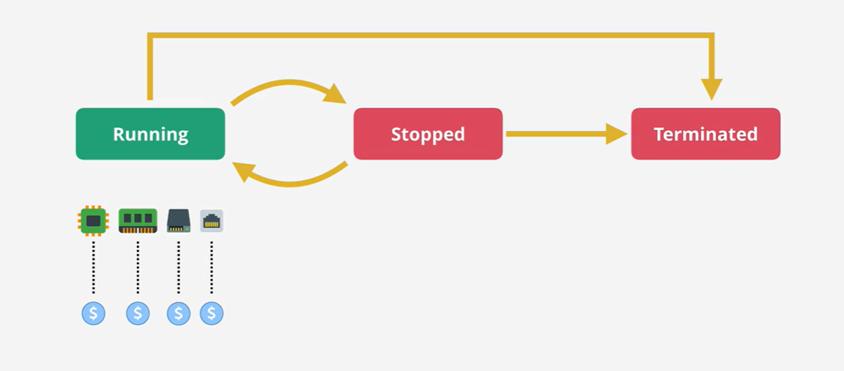
Instance LifeCycle

Slide 23
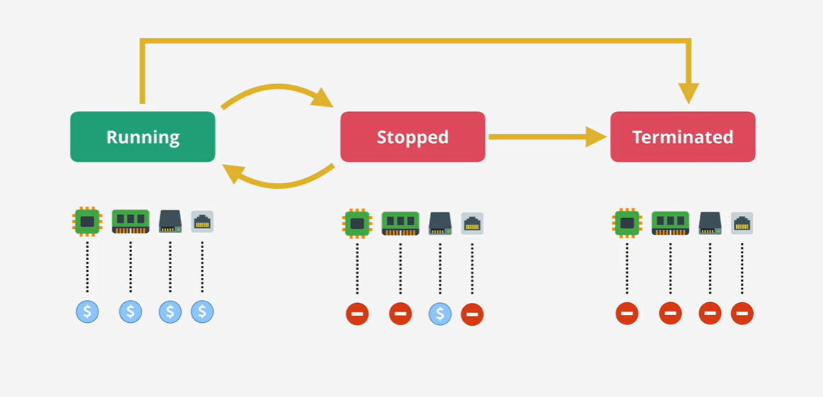
Instance LifeCycle

Slide 24
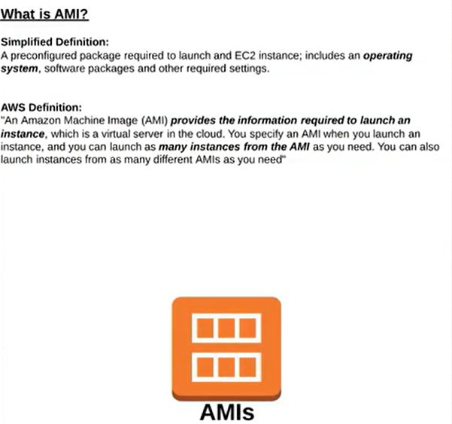
AMI – Amazon Machine Image

Slide 25
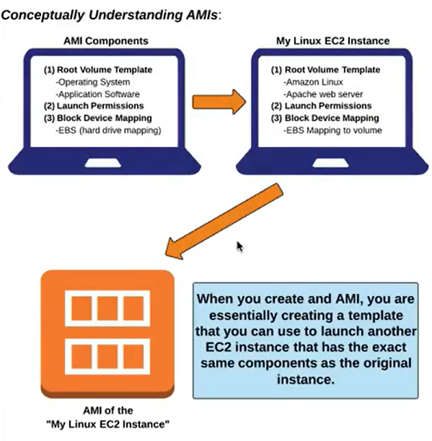
AMI Concept

Slide 26
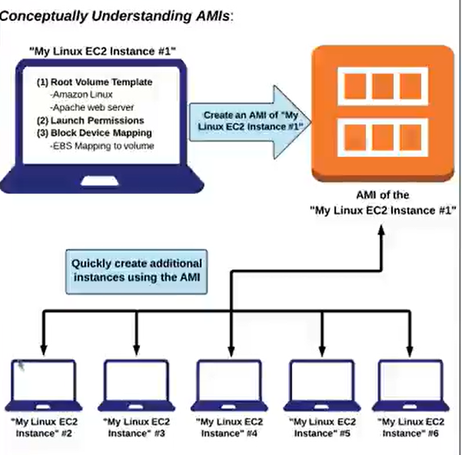
AMI Concept

Slide 27
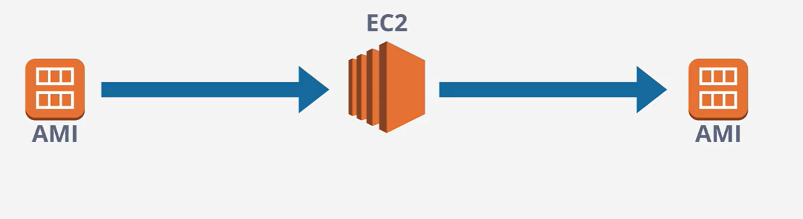
AMI

Slide 28
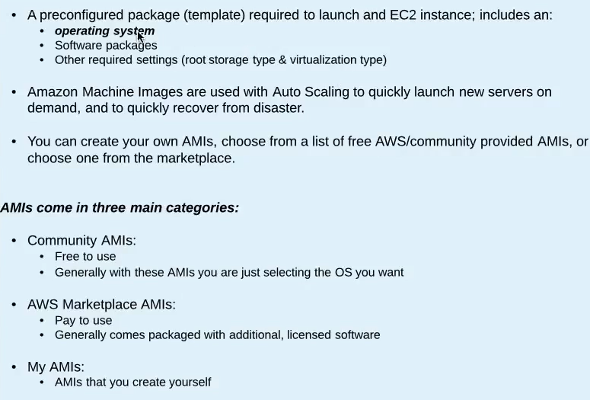
EC2 AMIs and Virtualization

Slide 29
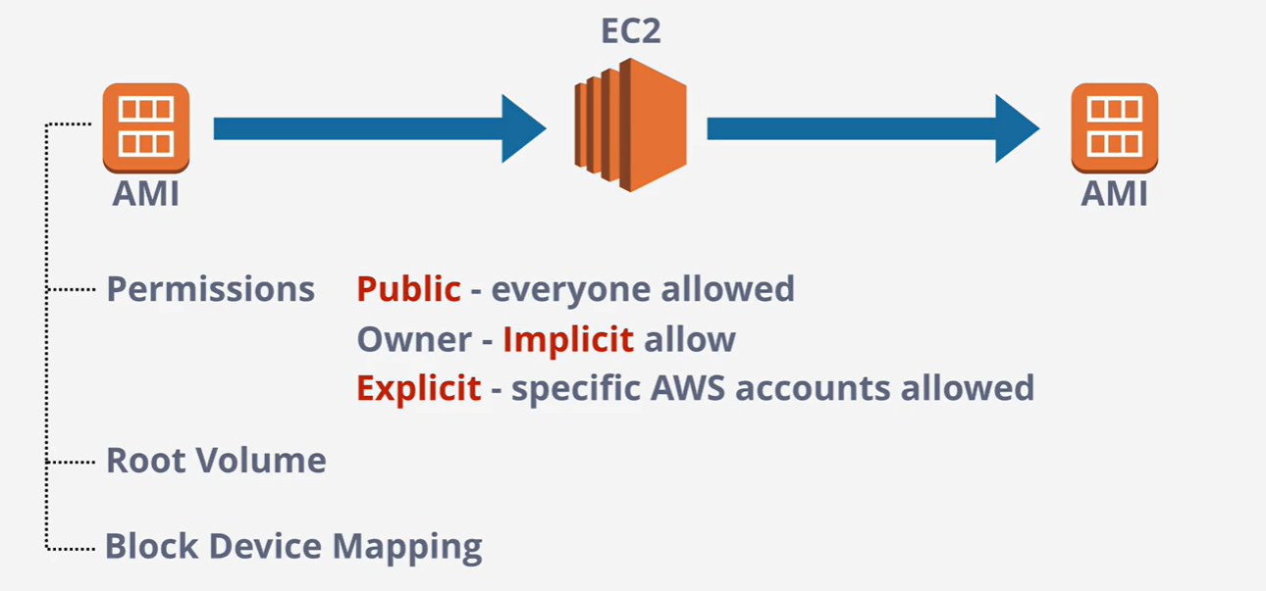
AMI

Slide 30
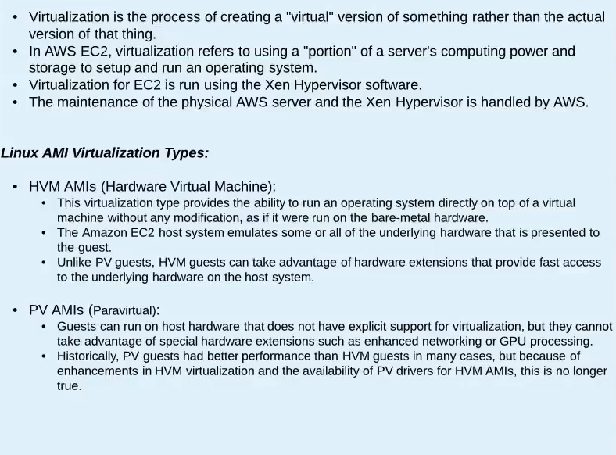
EC2 AMIs and Virtualization

Slide 31
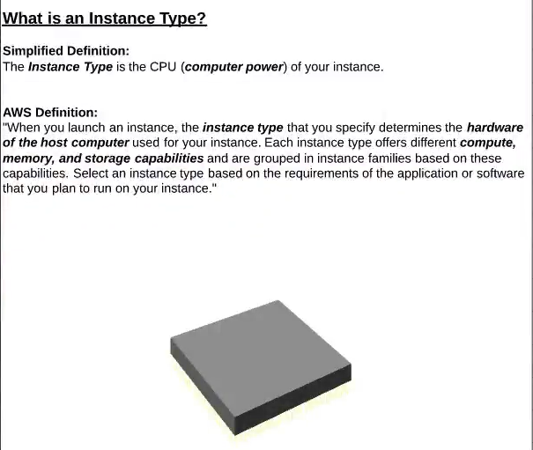
Instance Type

Slide 32
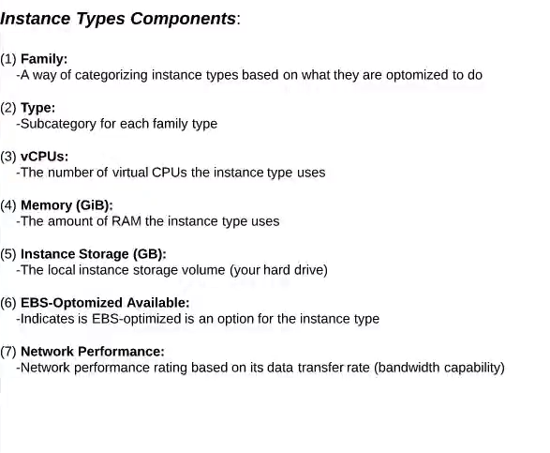
Instance Types
https://aws.amazon.com/ec2/instance-types/
Amazon EC2 Instance Comparison (vantage.sh)

Slide 33
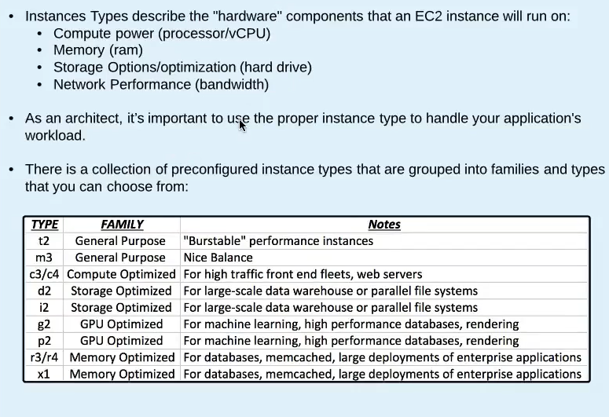
EC2 Instance Types

Slide 34
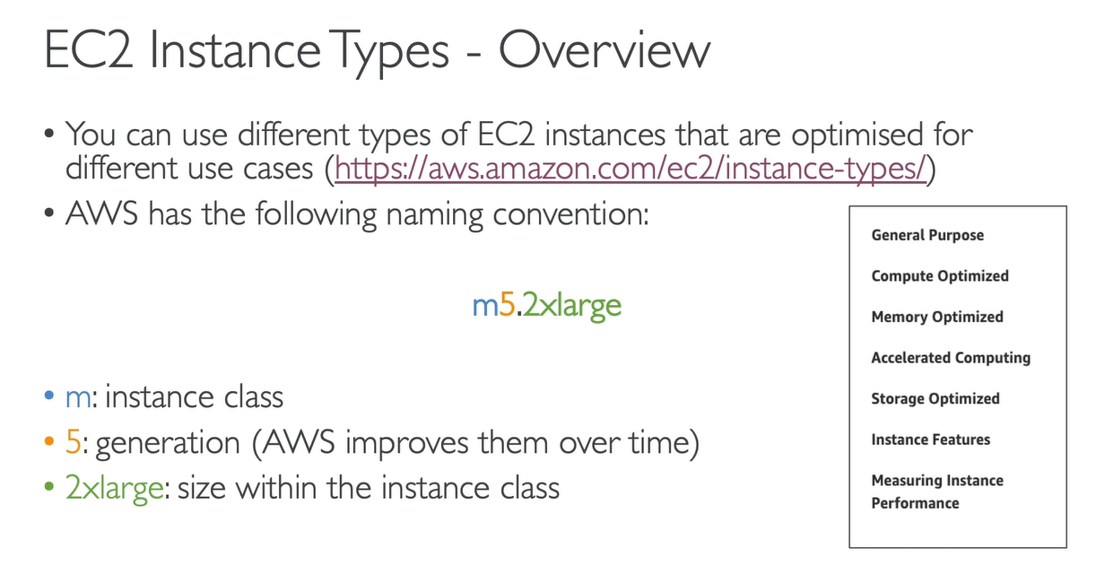
EC2 Instance Type

Slide 35
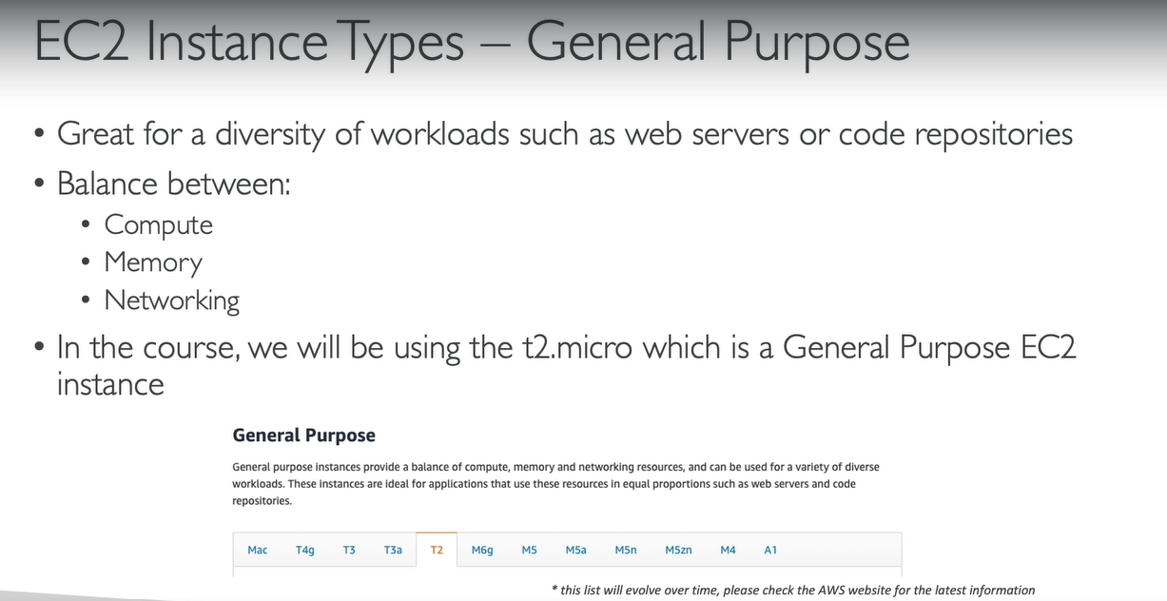
EC2 Instance Type

Slide 36
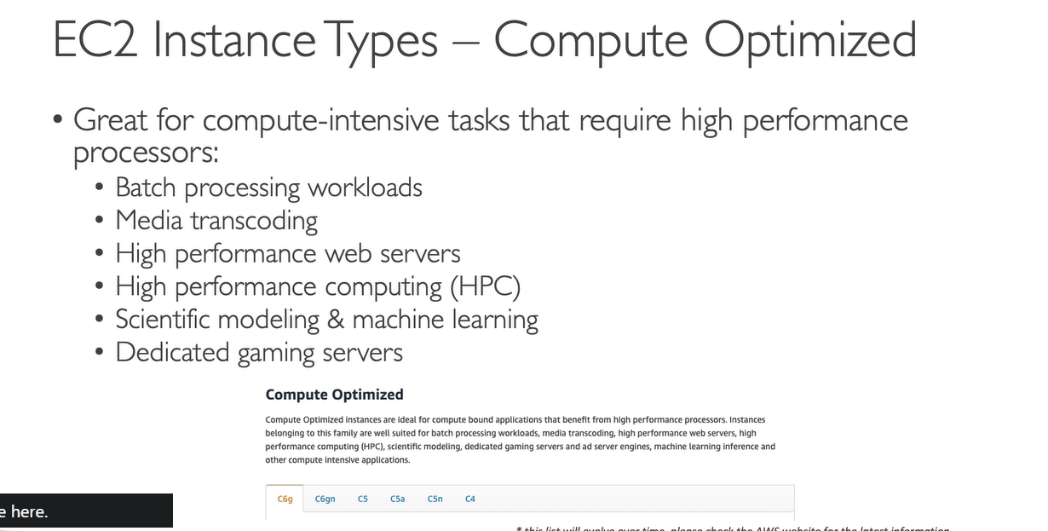
EC2 Instance Type

Slide 37
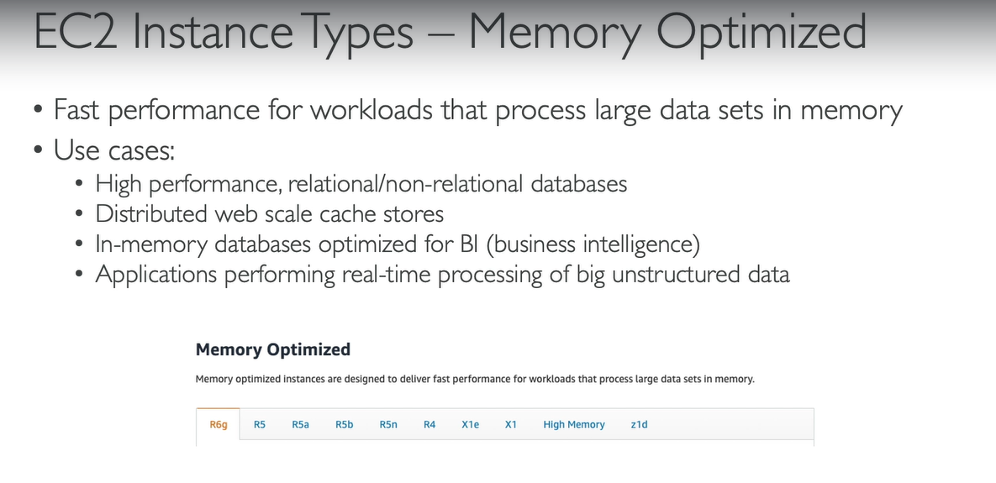
EC2 Instance Type

Slide 38
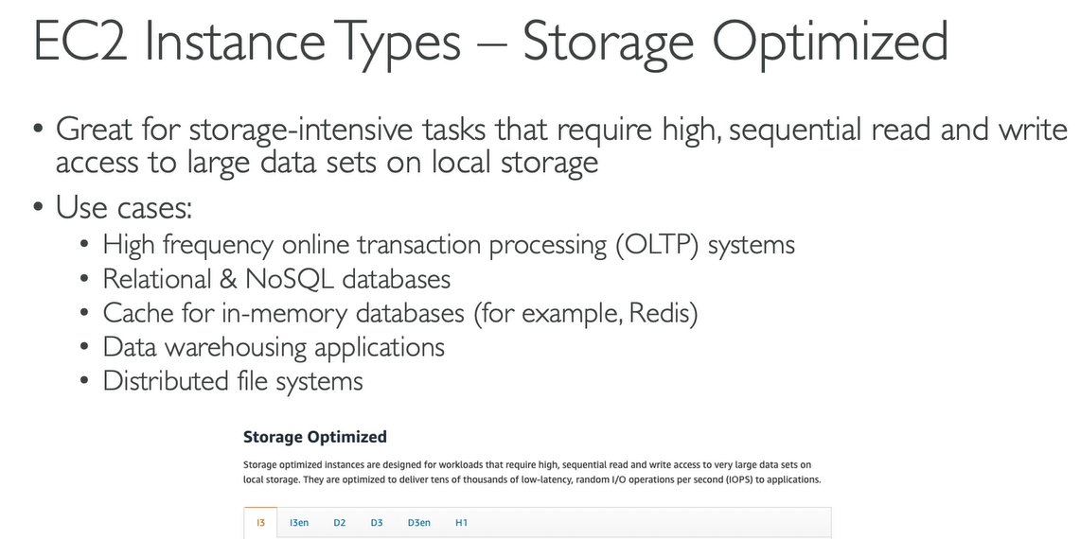
EC2 Instance Type

Slide 39
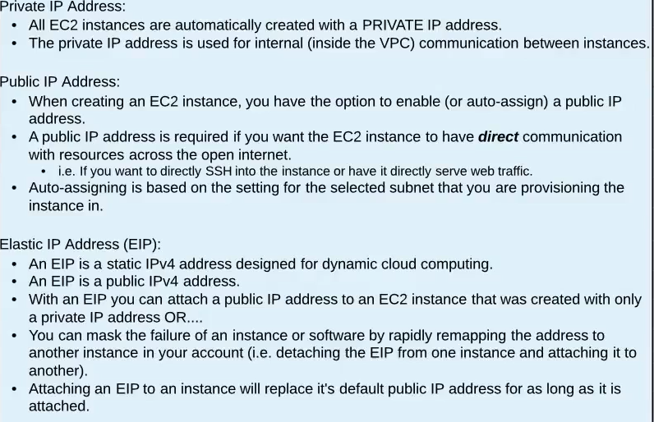
Public, Private and Elastic IP Address

Slide 40
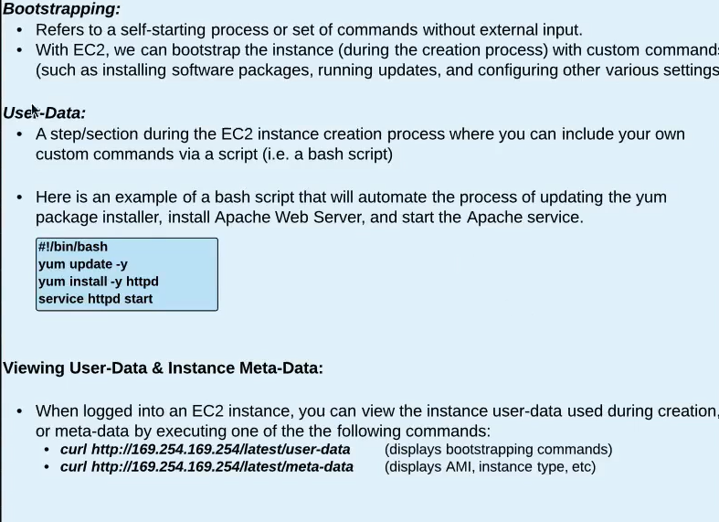
EC2 BootStrapping, User-Data and Meta-Data

Slide 41
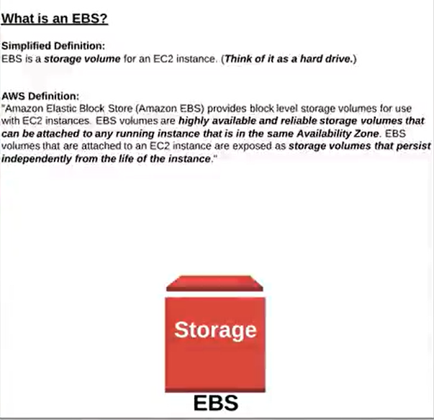
EBS – Elastic Block Store

Slide 42
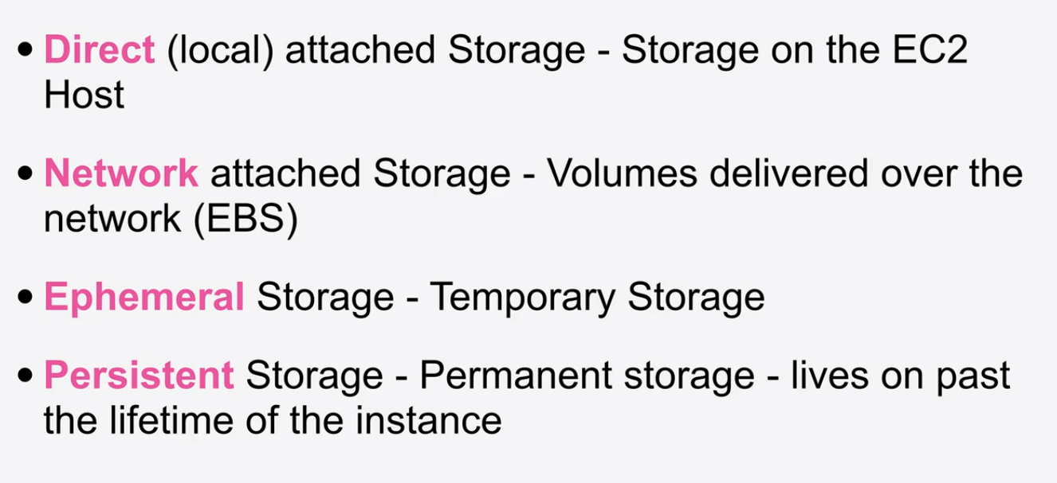
Storage – Key Terms

Slide 43
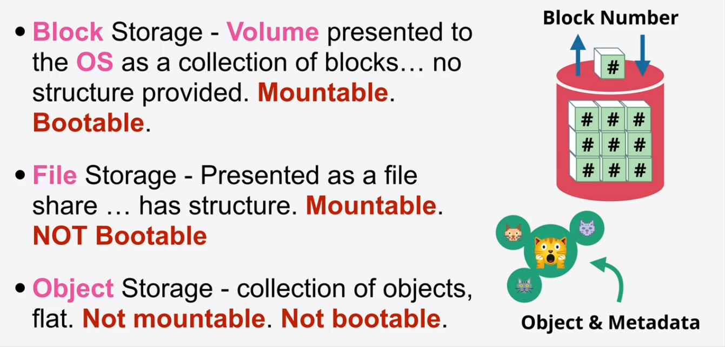
Storage – Key Terms

Slide 44
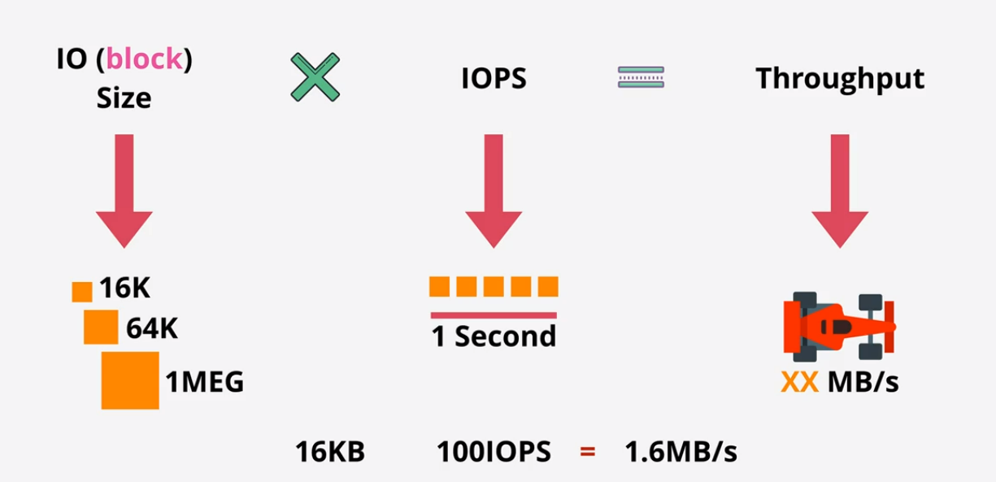
Storage Performance

Slide 45
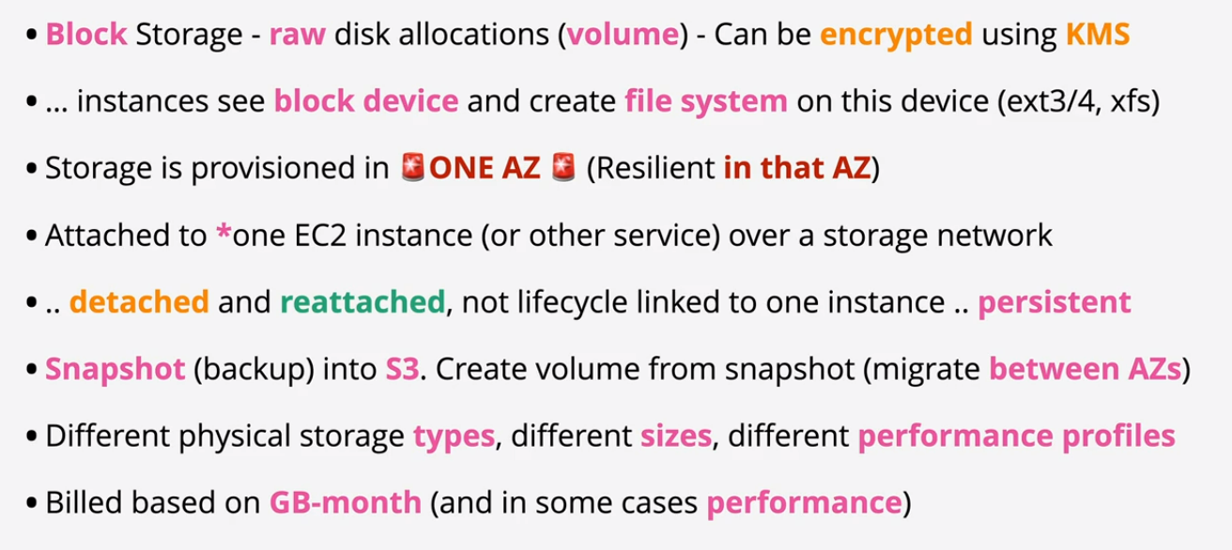
EBS Points

Slide 46
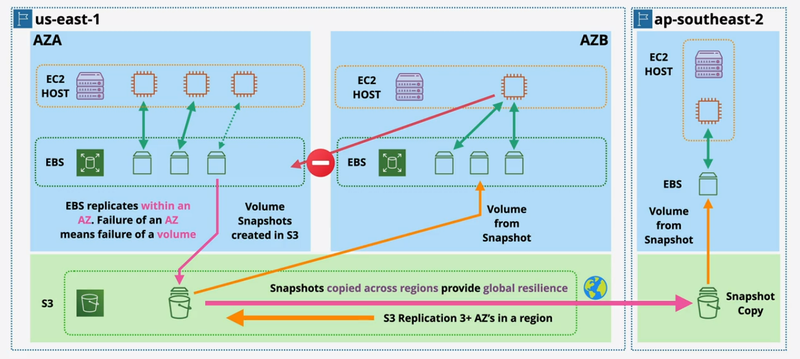
EBS Architecture

Slide 47
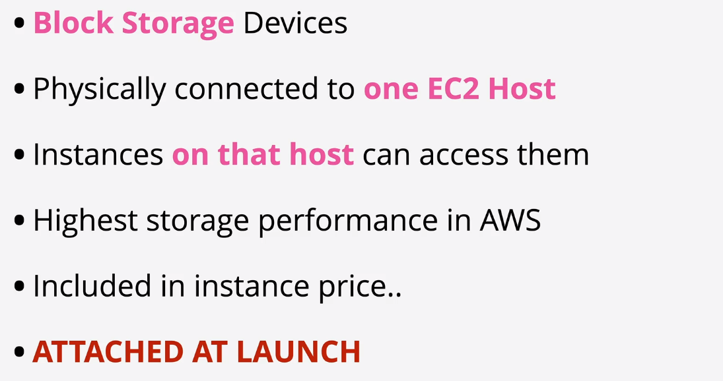
Instance Store Volumes

Slide 48
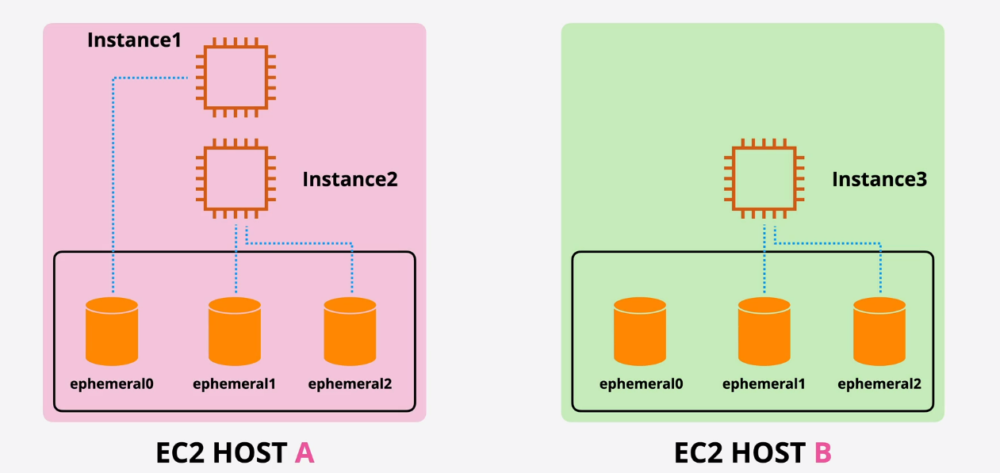
Instance Store Volumes

Slide 49
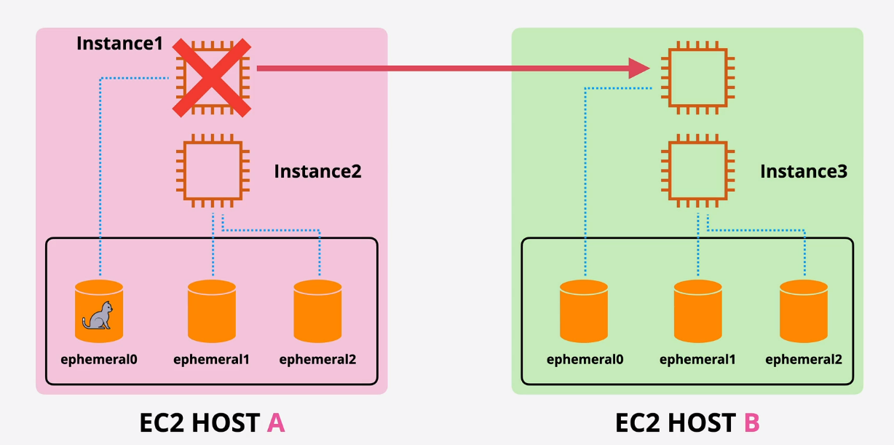
Instance Store Volumes

Slide 50
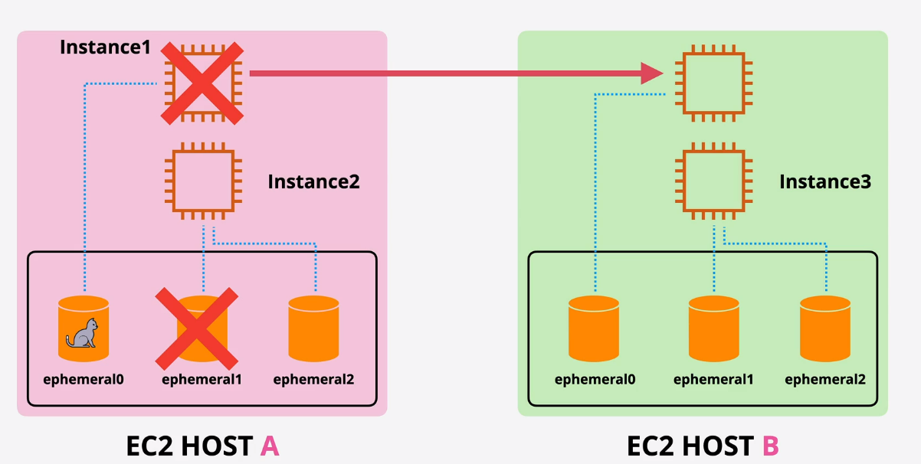
Instance Store Volumes

Slide 51
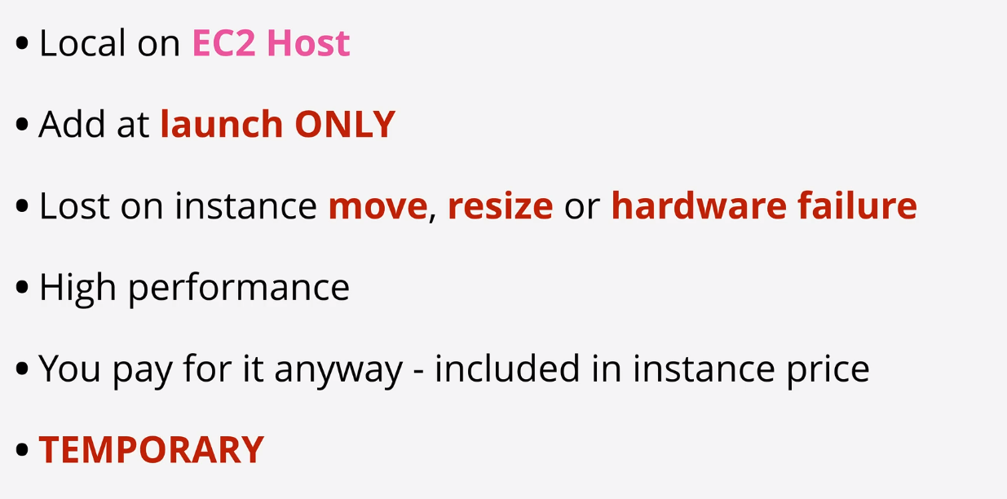
Instance Store Volumes

Slide 52

Choosing between Instance Store & EBS

Slide 53

EBS SnapShots

Slide 54

EBS Snapshots Architecture

Slide 55

EBS Concepts

Slide 56

Root vs Additional EBS Volumes

Slide 57

Root vs Additional EBS Volumes

Slide 58

EC2 Storage Options

Slide 59

EBS types

Slide 60

Instance Store

Slide 61

NACL

Slide 62

NACL

Slide 63

Security Groups

Slide 64

Security Groups

Slide 65

Security Groups

Slide 66

Security Groups

Slide 67

Security Groups

Slide 68

Security Groups

Slide 69

Security Groups

Slide 70

Security Groups Diagrams

Slide 71

Security Groups Diagrams

Slide 72

Security Groups Diagrams

Slide 73

Security Groups good to know

Slide 74

Referencing other Security Groups

Slide 75

Classic Ports to know

Slide 76

EBS Snapshots

Slide 77

EBS Snapshots

Slide 78

EC2 Placement Groups

Slide 79

EFS – Elastic File Systems

Slide 80

EC2 Troubleshooting Scenarios

Slide 81

IP Addressing

Slide 82

IP Addressing

Slide 83

IP Addressing

Slide 84

Launch and connect to an ec2 instance

Slide 85

Private and Public Key

